Slide 1
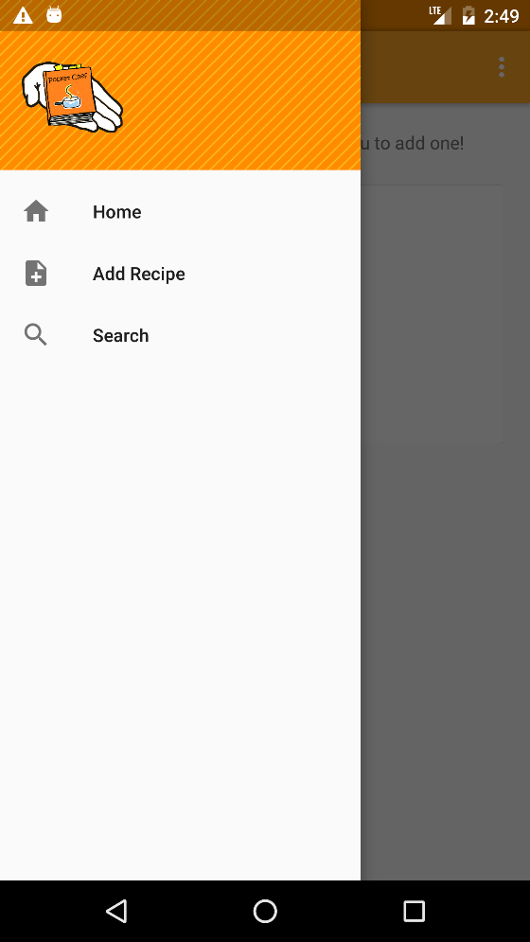
System Requirement
User should be able to perform an advanced search by category of food and ingredients used
Description | A text field near the top of the home page should allow the user to enter categories of food and ingredients to search the recipes in the database.
Requires | The local database and file access permissions from the user.
Pre-Condition | An existing database.
Post-Condition | A copy of the database that is in the desired location.
Side Effects | Depending on how the database system serves information, it may leave the database in read-only mode if we have to close existing connections.

Slide 2
System Requirement
User should be able to depend on the quick performance of the app (to improve productivity)
Description | The app should be quickly responsive to all commands of the user, enabling the user to easily navigate and use the app.
Requires | None
Pre-Condition | None
Post-Condition | None
Side Effects | None

